Slide 1

INSURANCE ANALYTICS
Insurance Analytics
Transforming Claims & Policy Data into Strategic Business Intelligence
Sample Analytics Deck | Claims · Underwriting · Retention

Slide 2
AGENDA
What We'll Cover
1
Group Details
5
Power BI dashboard
2
Project summary
6
Tableau dashboard and SQL Data transformation
3
Key Performance Indicators
7
Strategic Recommendations
4
Excel Dashboard
8
Key Takeaways

Slide 3
OVERVIEW
Project Summary
Built an end-to-end Insurance Analytics dashboard analyzing 48,500 policies across auto, property, health and liability lines, tracking $184.6M in gross written premium and $102.3M in paid claims. The dashboard tracks underwriting, claims settlement, fraud, and customer retention KPIs.
2025 FORECAST
Momentum Continues Into Next Year
Gross Written Premium
$204.0M
Key Insights
North America led all regions with $98.4M GWP and 41,300 policies.
+10.5% vs. current year
Total Claims Paid
Auto Insurance was the top revenue line at $71.2M GWP.
$109.0M
Claims settlement rate reached 93.2% with 5.8-day average processing time.
Loss ratio held near 53%
Loss ratio held at 55.4%, keeping the combined ratio at a healthy 96.1%.
Active Policies
53,800
Fraud analytics flagged and prevented $6.8M in suspicious claims.
+10.9% policy growth
Insurance Analytics
3

Slide 4









METRICS
Key Performance Indicators
REVENUE & GROWTH
PORTFOLIO SIZE
CLAIMS PERFORMANCE
$184.6M
48,500
93.2%
Gross Written Premium
Active Policies
Claims Settlement Rate
OPERATIONAL SPEED
UNDERWRITING HEALTH
PROFITABILITY
5.8 days
55.4%
96.1%
Avg. Claim Processing
Loss Ratio
Combined Ratio
LOYALTY
SATISFACTION
RISK CONTROL
88.6%
64
$6.8M
Customer Retention
Net Promoter Score
Fraud Value Prevented
Insurance Analytics
4

Slide 5
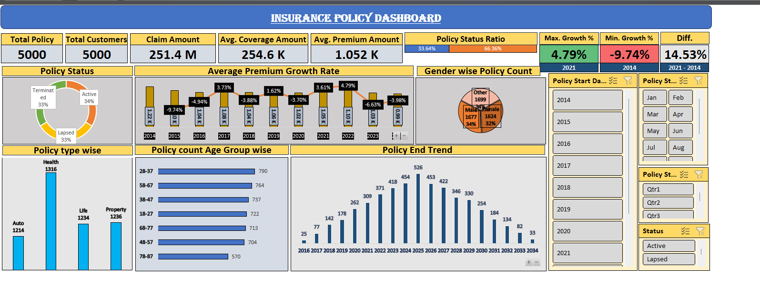
Excel Dashboard

Slide 6
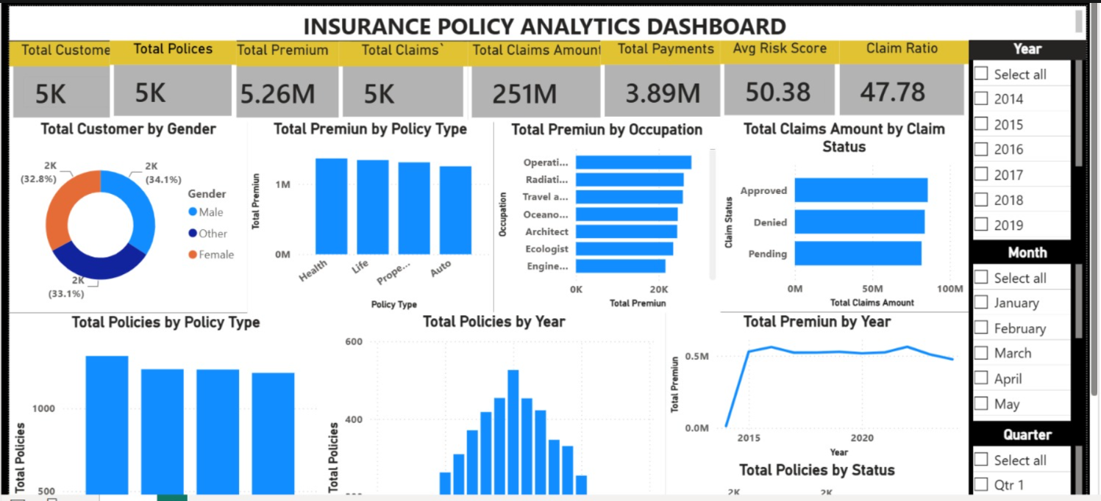
Power BI Dashboard

Slide 7
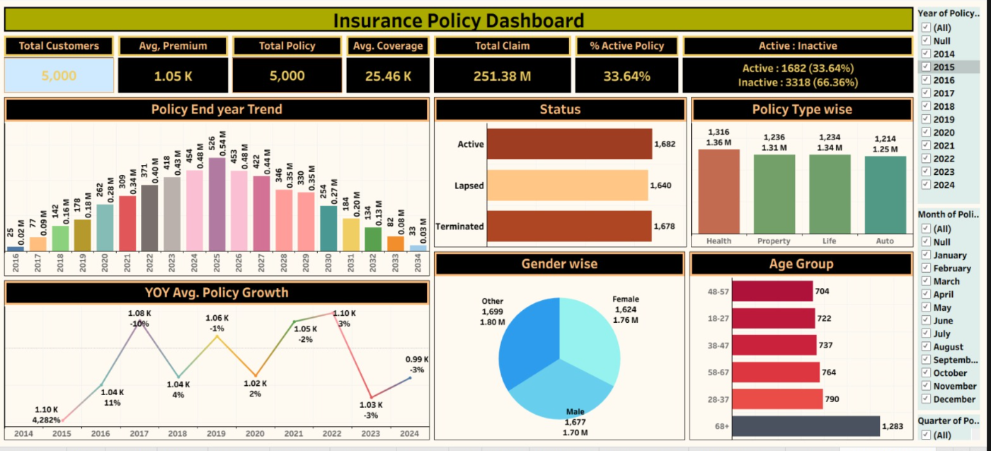
Tableau Dashboard

Slide 8
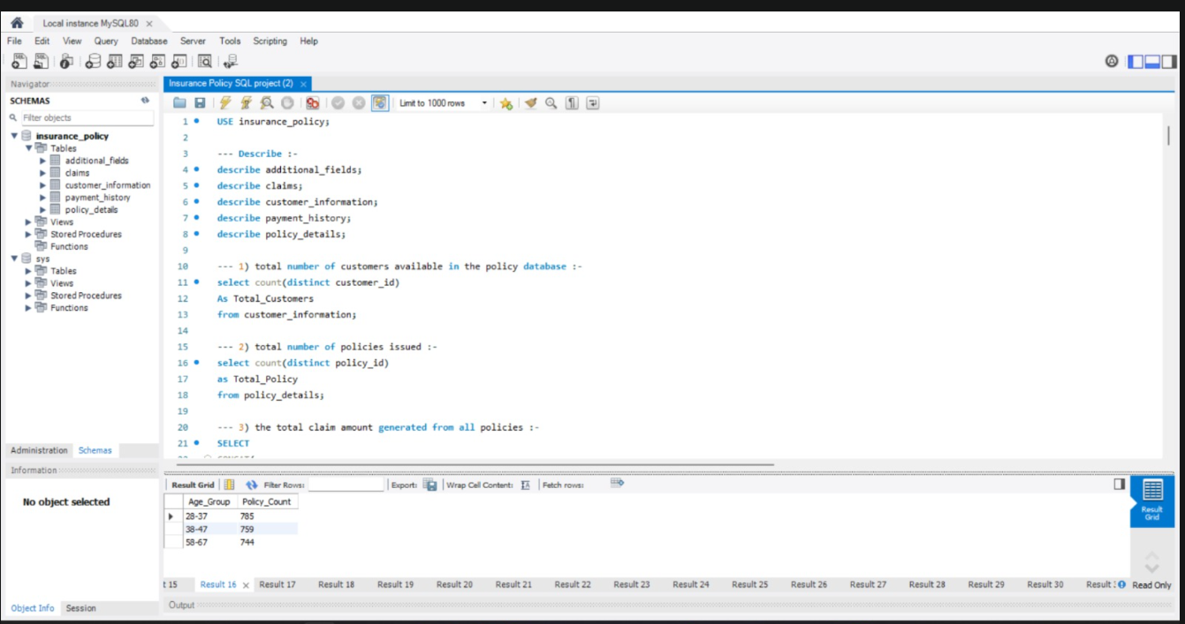
SQL Data Transformation

Slide 9


STRATEGY
Strategic Recommendations
Scale Auto Insurance
Accelerate Claims Processing
Expand in North America
Top revenue line at $71.2M GWP — prioritize product and marketing investment.
Cut average processing time from 5.8 to under 4 days with automated triage.
Leading region at $98.4M GWP and 41,300 policies — fund further growth.
Strengthen Fraud Detection
Lift APAC Retention
Sustain Underwriting Discipline
Scale the ML model that already prevented $6.8M in suspicious claims.
Lowest regional retention at 82.6% — launch targeted loyalty programs.
Maintain the 96.1% combined ratio and 55.4% loss ratio through cycle.
Insurance Analytics
9

Slide 10
CLOSING
Key Takeaways
This analysis supports strategic decision-making by strengthening underwriting discipline, accelerating claims processing, and deepening customer retention — driving sustainable, profitable growth across every line of business.
93.2% Settlement Rate
96.1% Combined Ratio
88.6% Retention
$6.8M Fraud Prevented
Insurance Analytics
10

Slide 11


